Slide 1
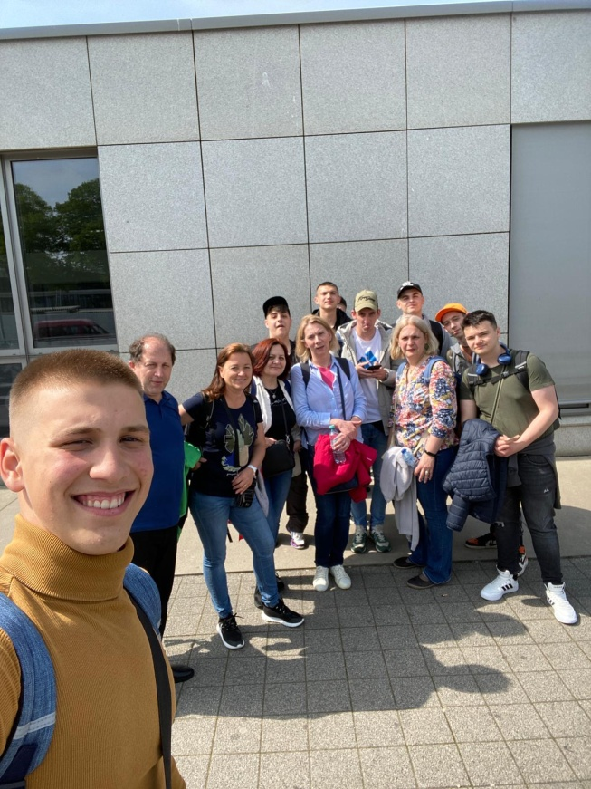
Arrivel day, Sunday 21.05.23
Flight from Cluj to
Dortmund

Slide 2
Dinner together at viet-village finally in Cologne

Slide 3
Monday 22.05.2023 The First Day

Slide 4
Seeing each other after a long time
When we met each other again for the first time in 6 months the morning we said hello to each other and we received a welcome gift from the other kids.

Slide 5
Tour of the school
After receiving the gifts we got a tour from the German students of the school.
The first thing we saw was the therapy room where you can get help with a therapy dog. the room was very cool.

Slide 6
We showed the Romanian students the school and show the classroom from ms bader und the pc room.

Slide 7
Cologne dome
After they showed us the school we visited Cologne dome. We wanted to climb inside the tower but it was closed so we went to have lunch. After lunch when the tower was open we climbed all the way up.

Slide 9
It was a nice first day!

Slide 10
Tuesday Cooking together!
On Tuesday We Cooked Wiener Schnitzel,Potato Salad And Asparagus Soup!

Slide 11
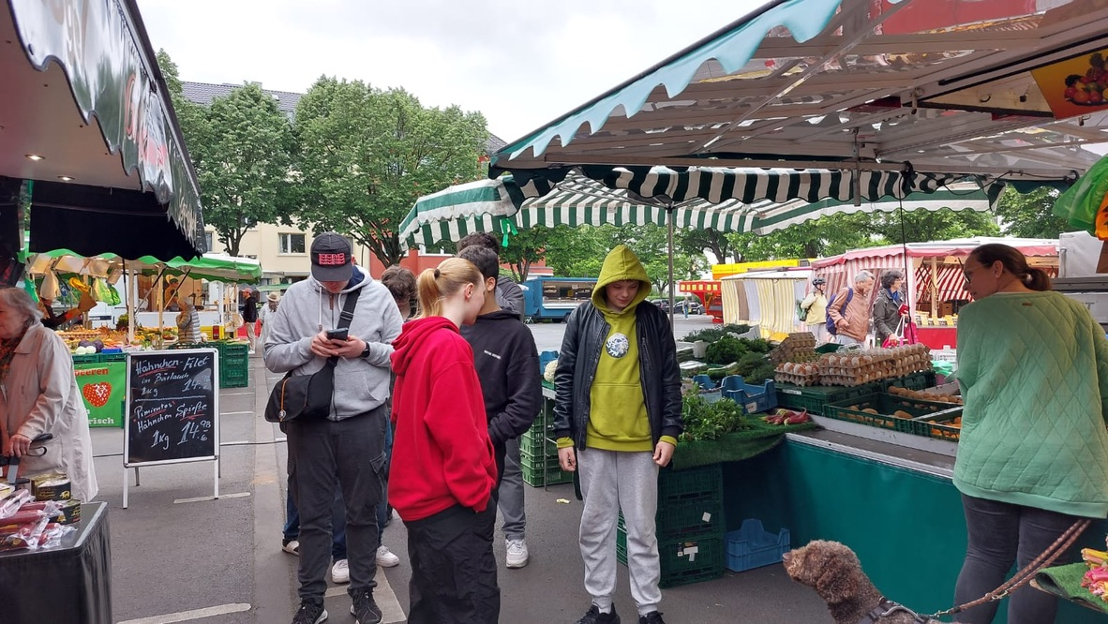
At first we went to the market and bought some fresh aspargus, potatos, cucumber, and some eggs, strawerries and vanilla ice cream

Slide 12
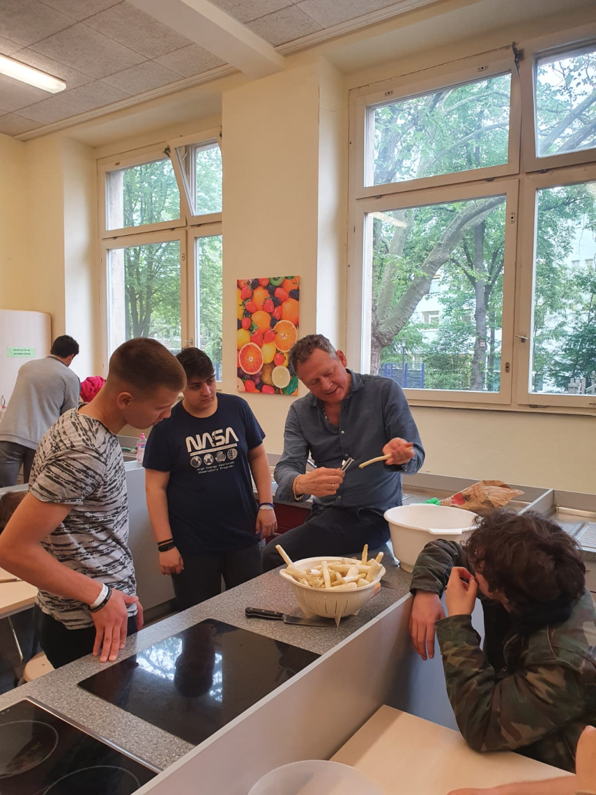
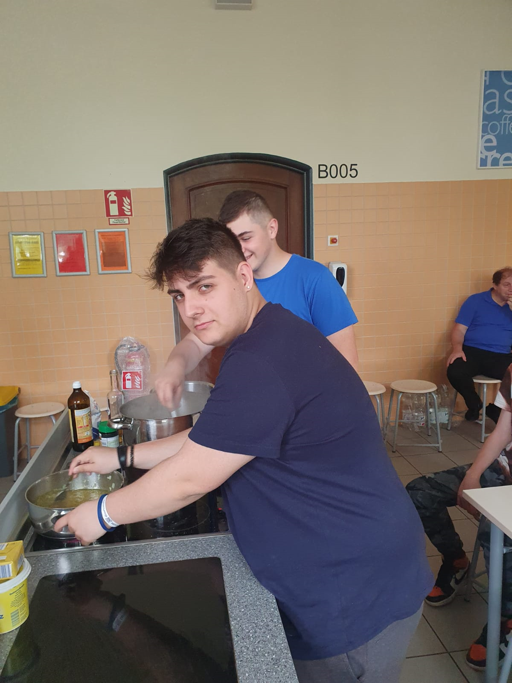
Alex preparet the sauce for the potato and cucumber Salad
Here we peeled off the aspargus for the spargelscremesuppe

Slide 13
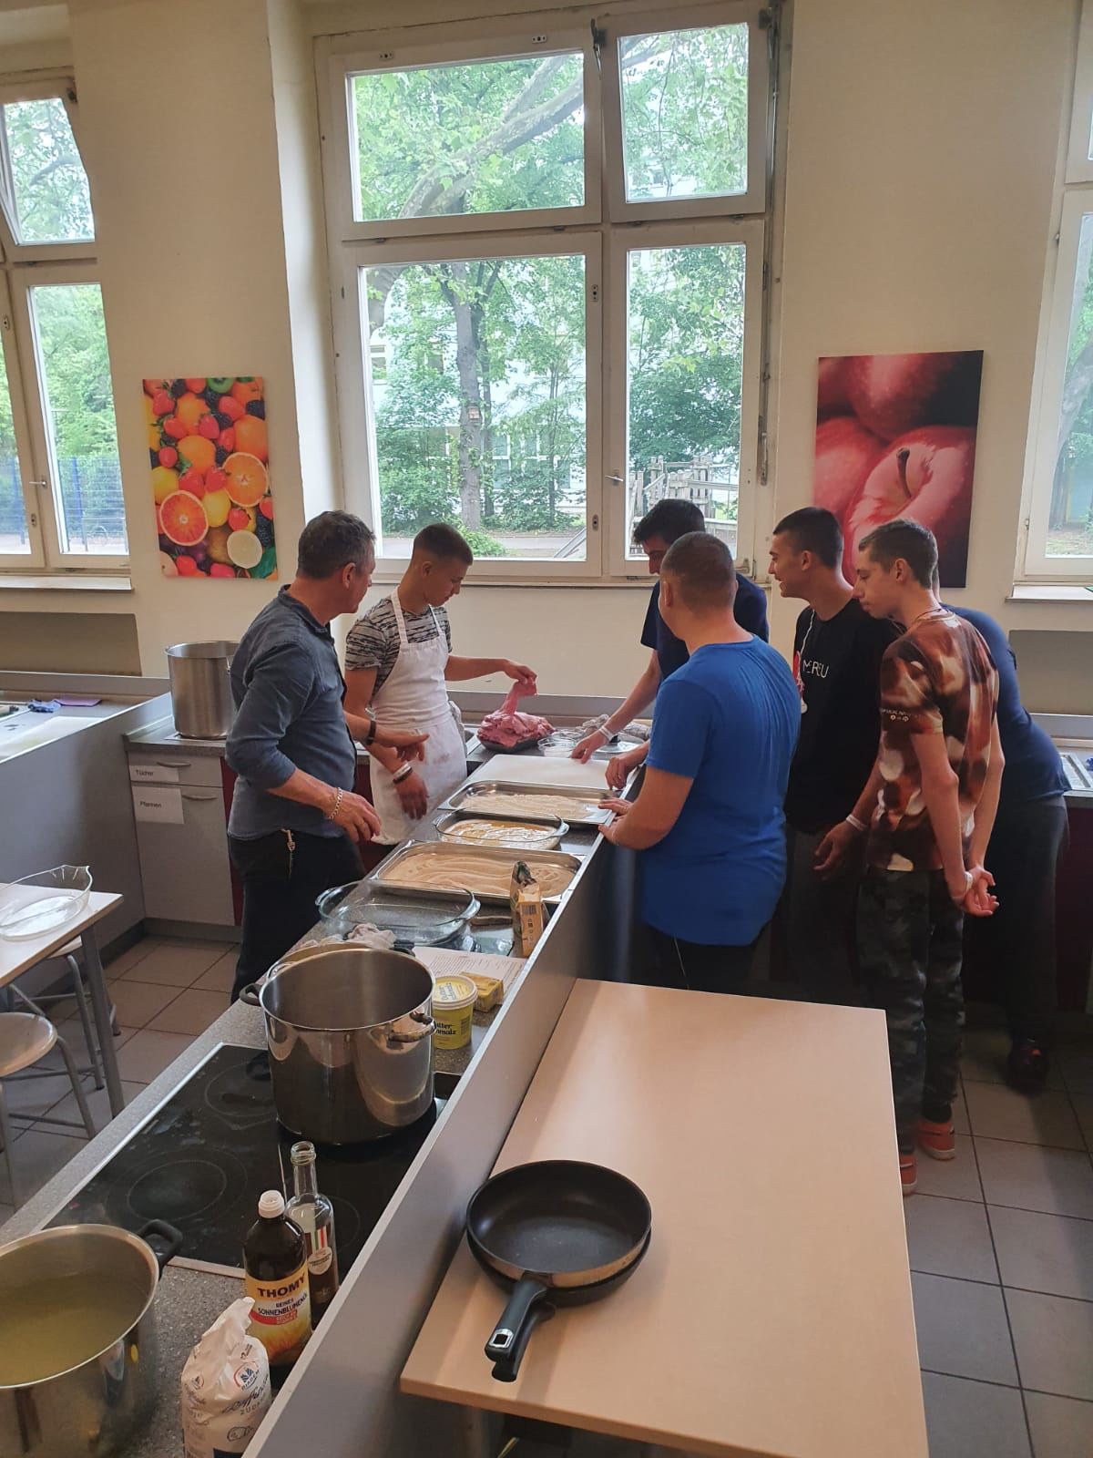
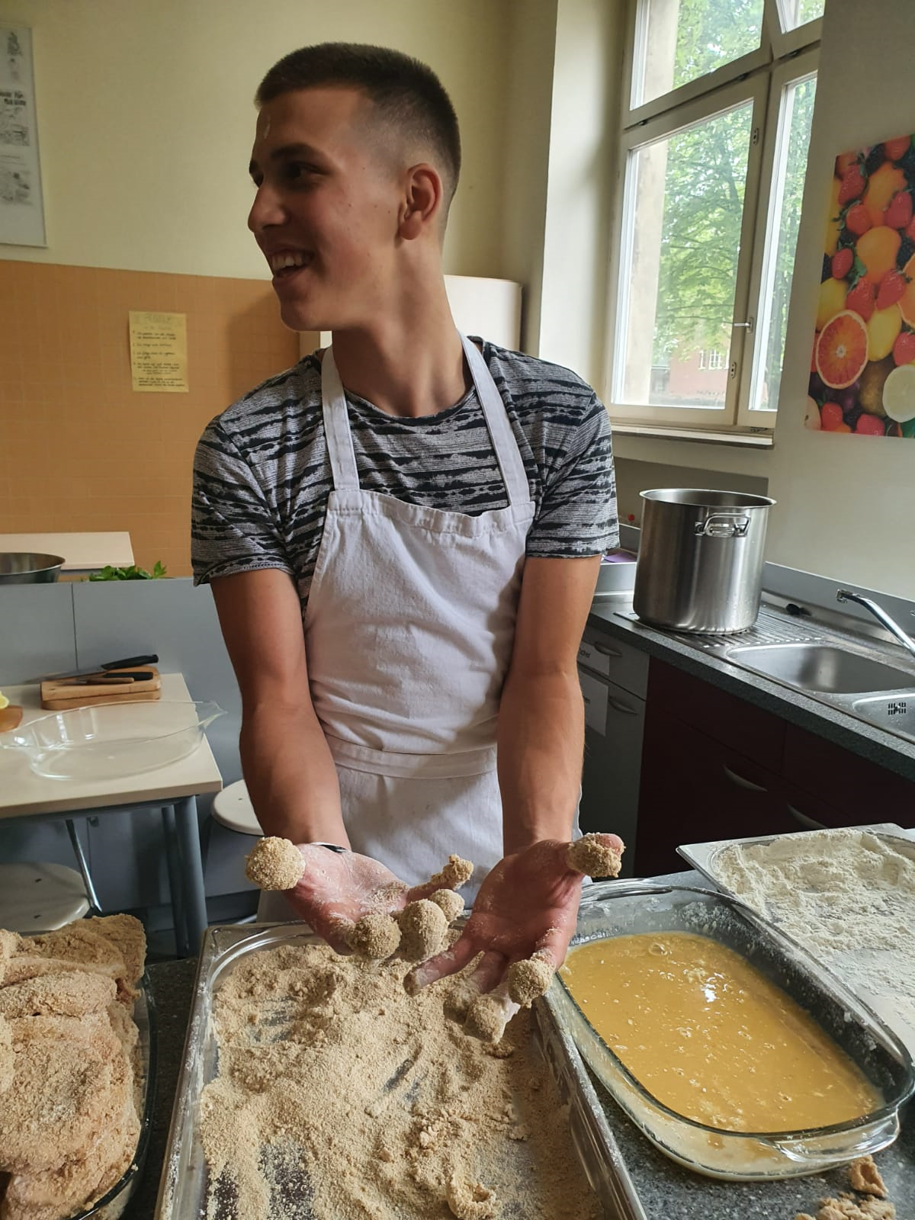
On This Picture Raul made the wiener schnitzel for the hole group. He breaded the schnitzel and put it in a pan with butter and cooked it.

Slide 14
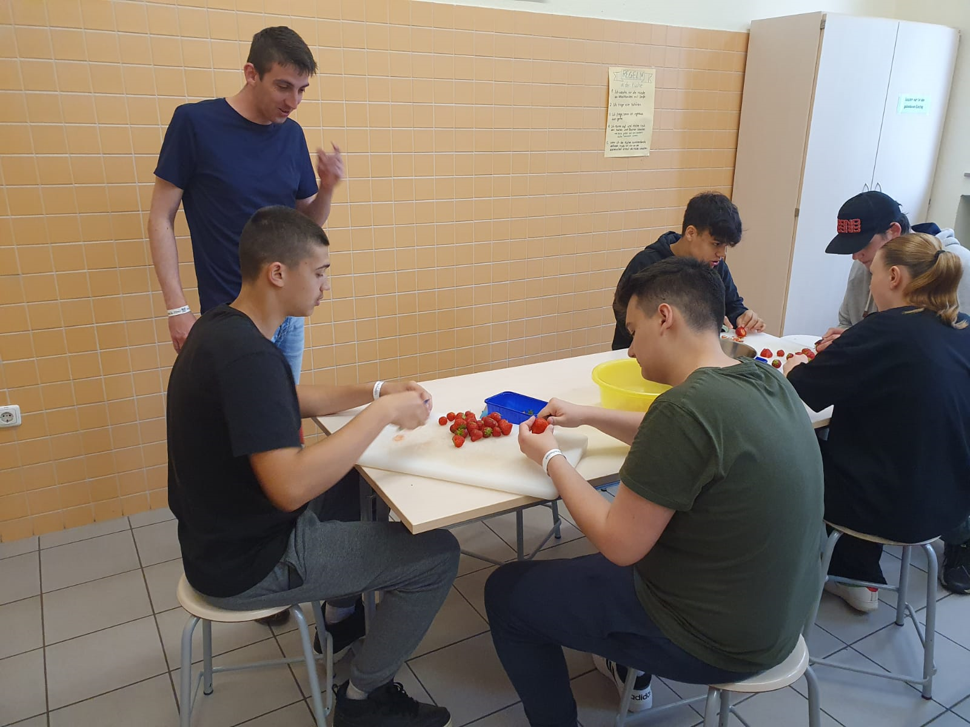
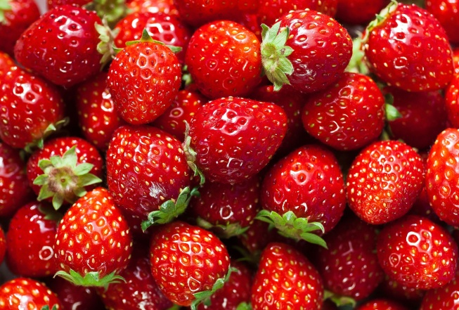
After we made the wiener schnitzel and the Spargelcremesuppe we cut the strawberries for the little desert after the main dish

Slide 15
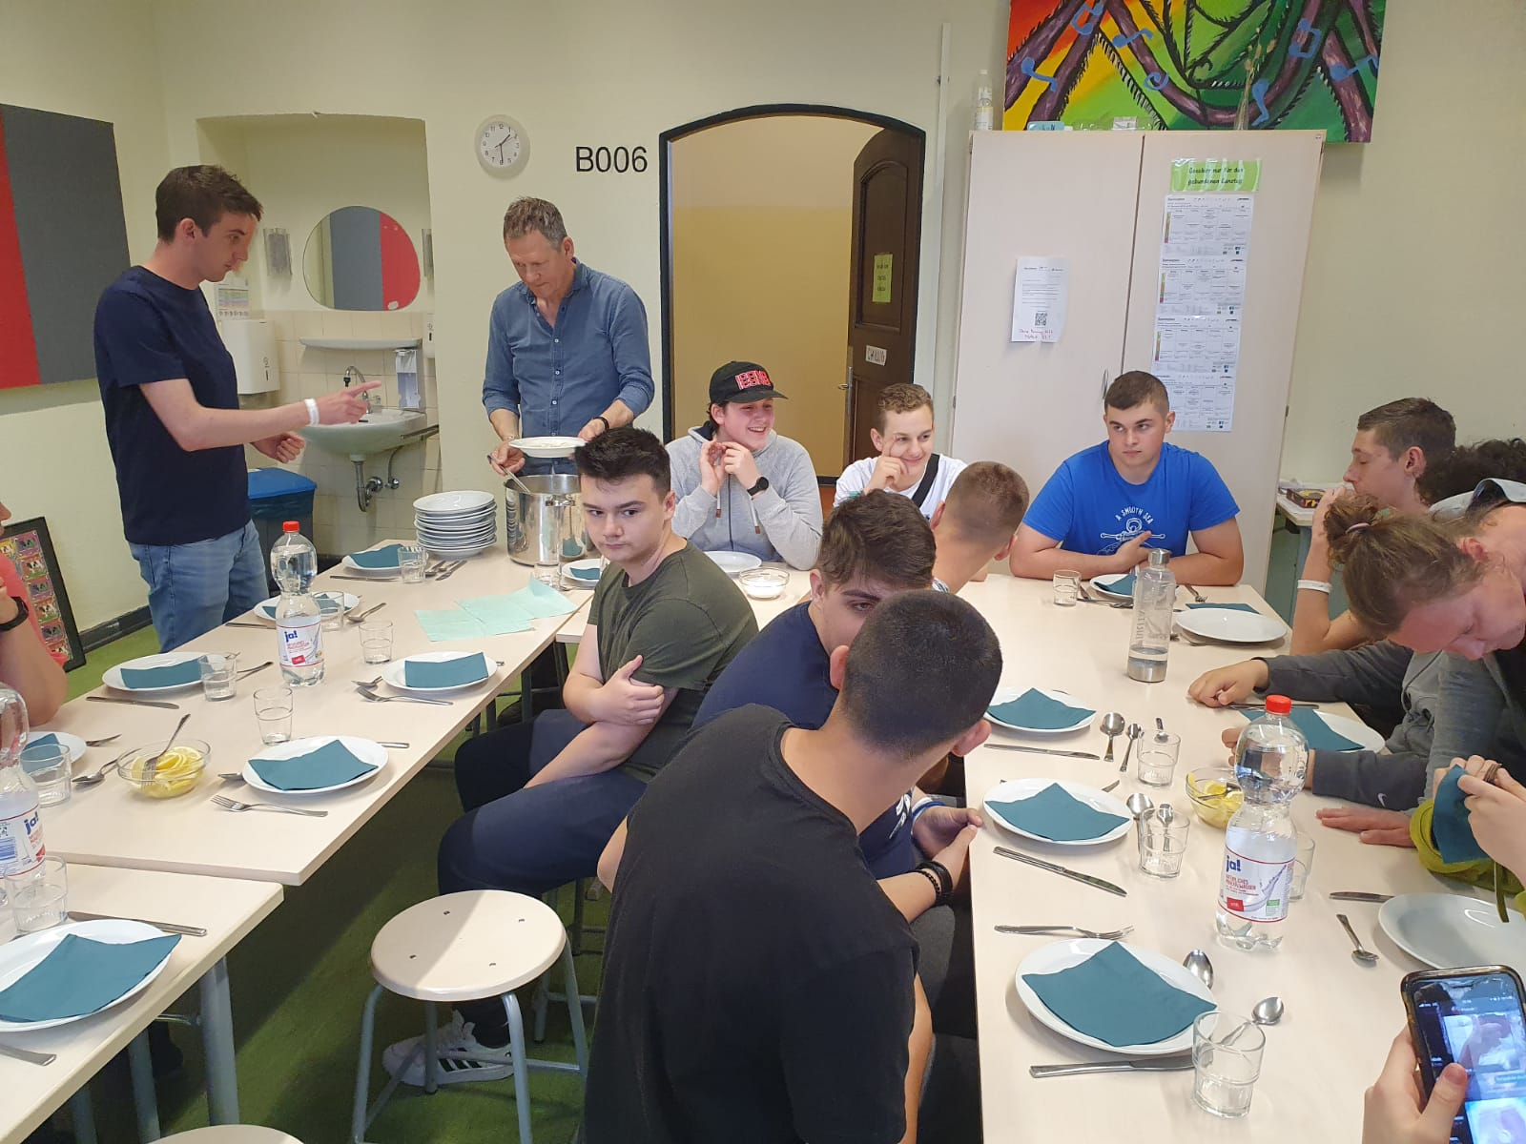
After we finished work we all set
on the table and ate the delicious aspargus soup !

Slide 16
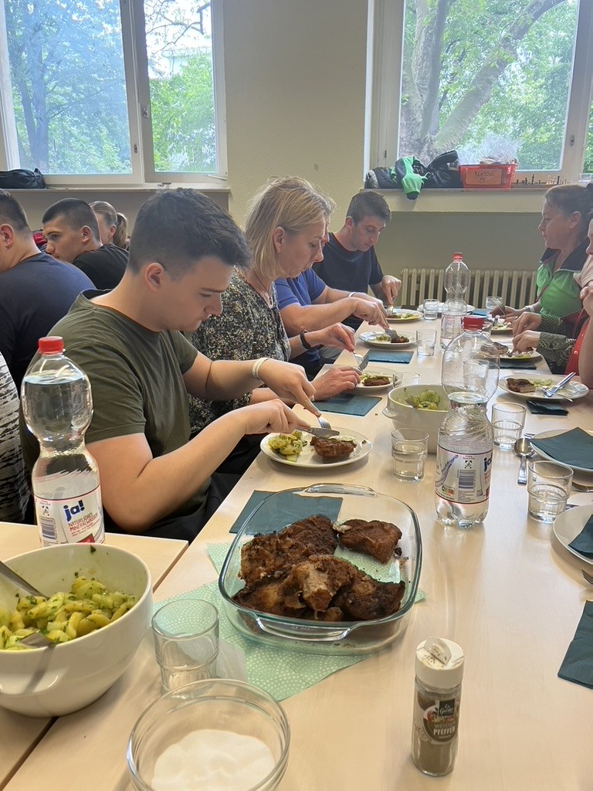
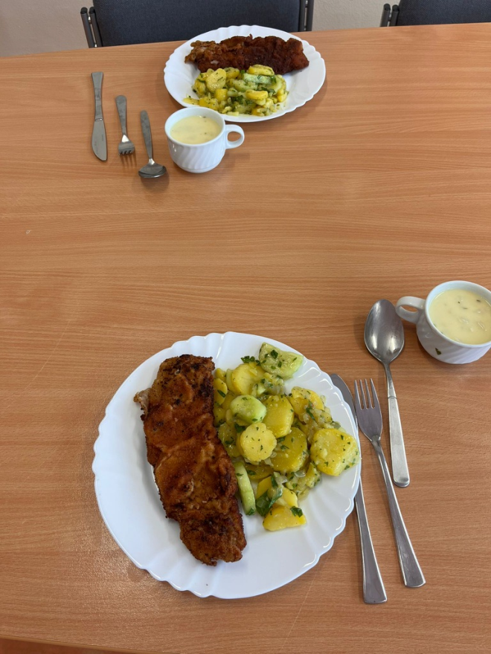
Then after we ate the aspargus soup we had some delicious wiener schnitzel with potato and cucumber salad. it was also very delicious!

Slide 17
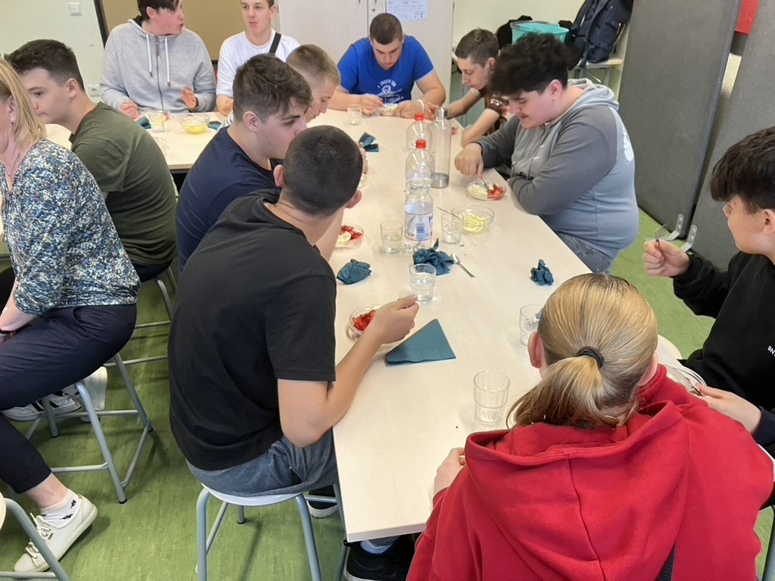
Afterwards we had a delicious desert with strawberries with vanilla ice cream and some mint

Slide 18
Tuesday At the Museum
23.05.2023
At Tuesday we went to Visit the Sport Museum in Cologne

Slide 19
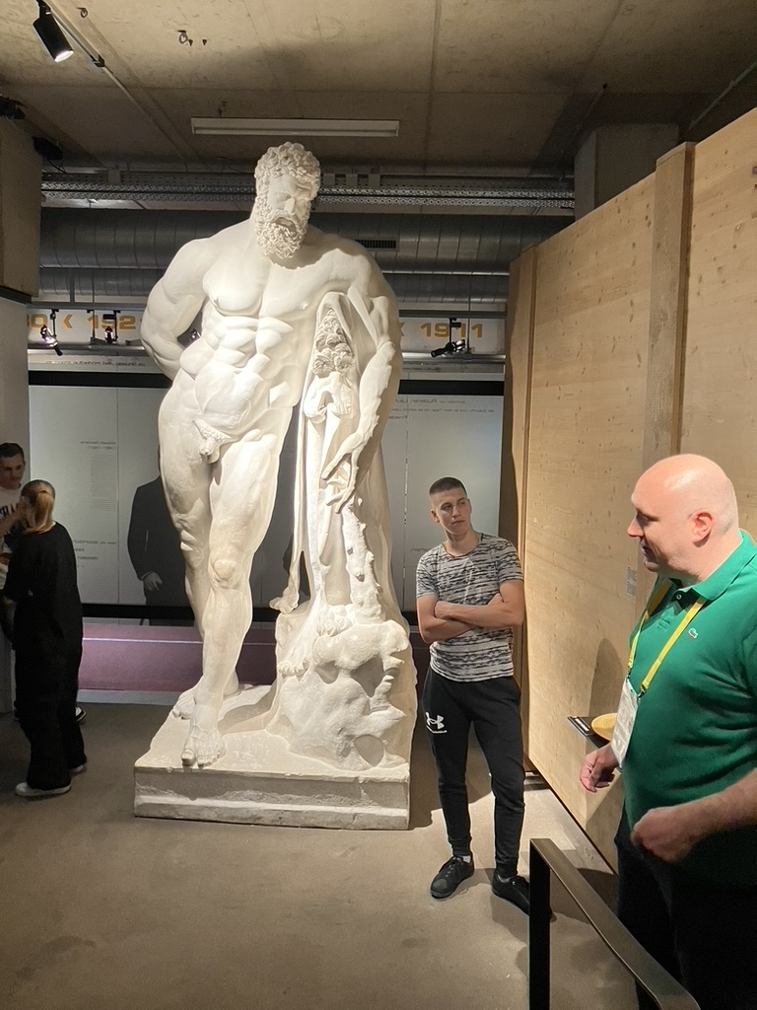
First time in the sport museum.

Slide 20
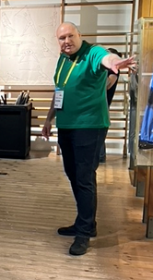
This bald guy showed us everything

Slide 21
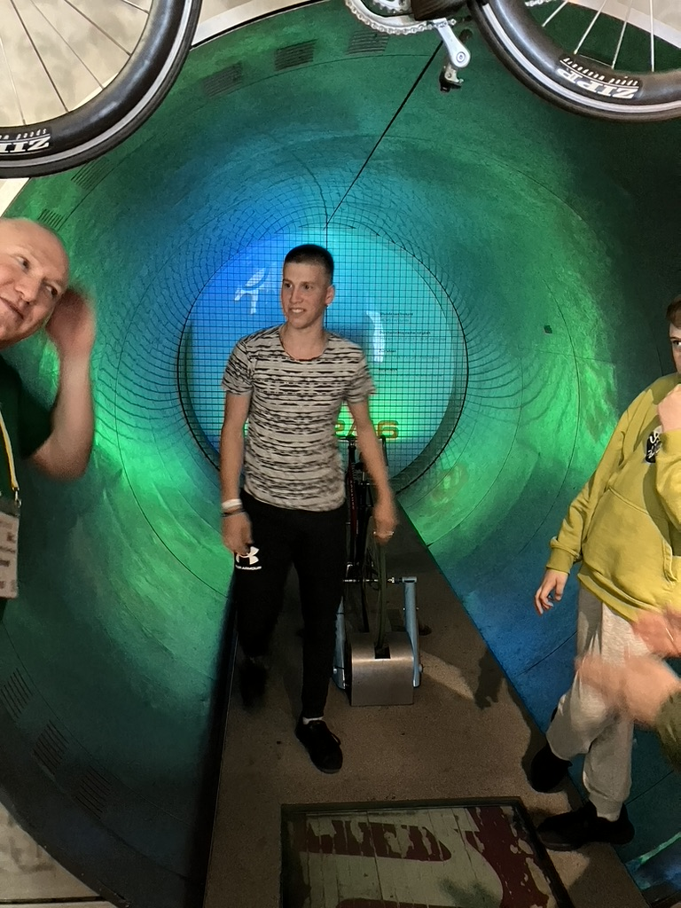
We had lots of fun there

Slide 22
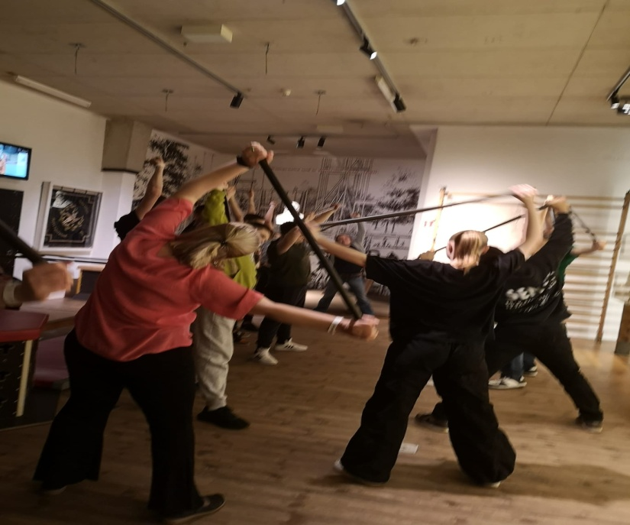
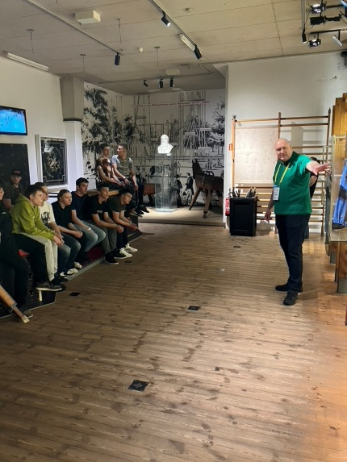
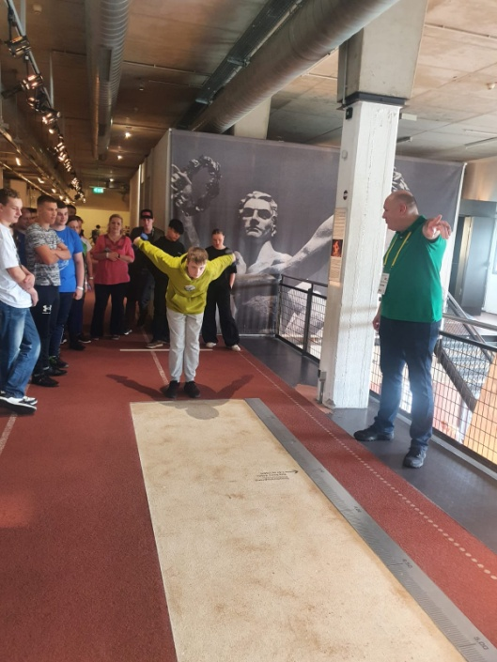
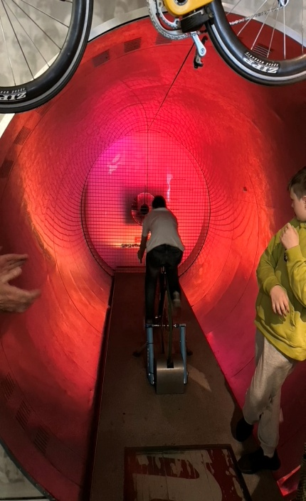
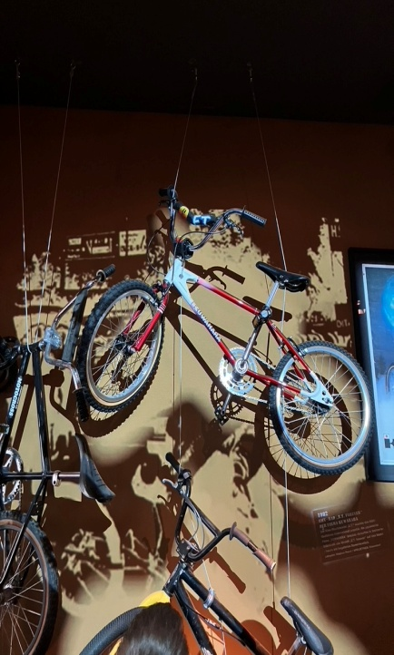
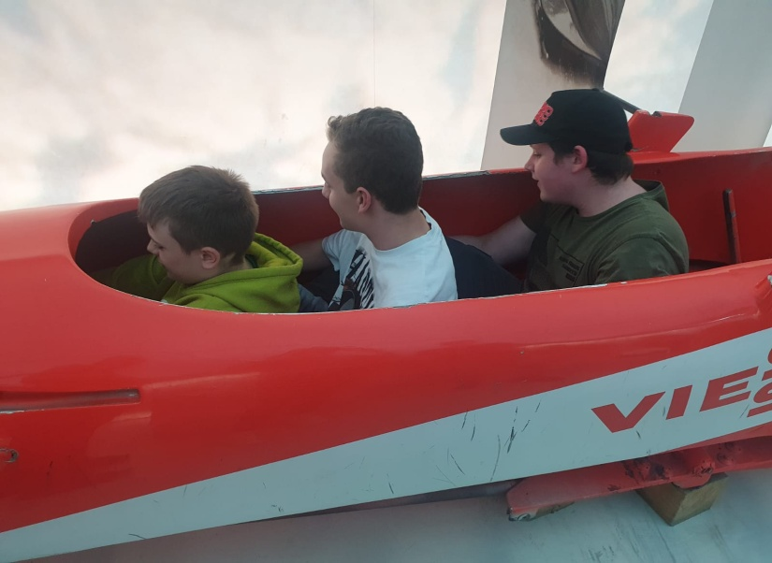
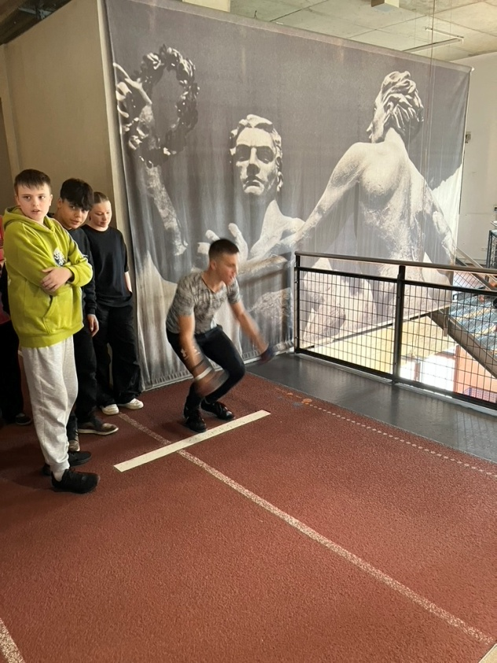
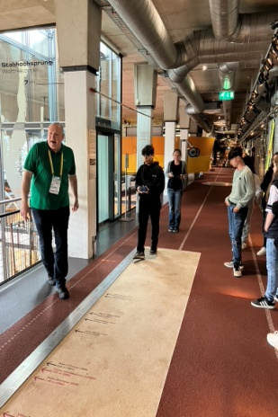
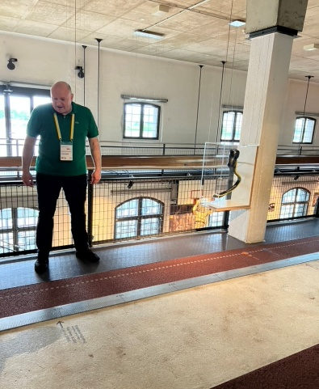
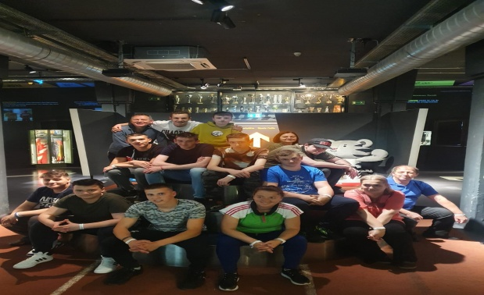
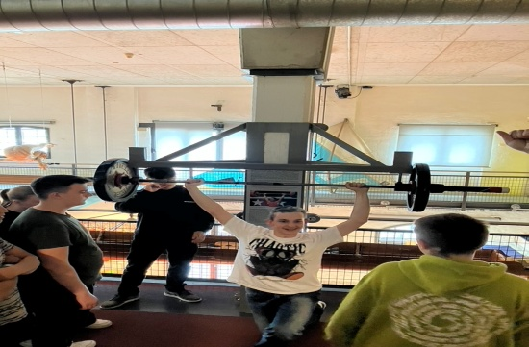
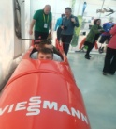
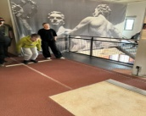

Slide 23
Wednesday
Escape room.
24.05.23

Slide 24
We started on Wednesday with getting a box with a mission.

Slide 25
We needed to find out what happened with this lake.

Slide 26
We had much ideas and a lot of fun, but still we didnt knew what happened

Slide 27
We were at a statue and got more and more hints and continued.

Slide 28
The lake is maybe poisoned.

Slide 29
We found out that the lake is poisoned.

Slide 30
We descovered that a women poisoned the lake at the wedding.

Slide 31
Thursday 25.05.2023 Battle the teacher

Slide 32
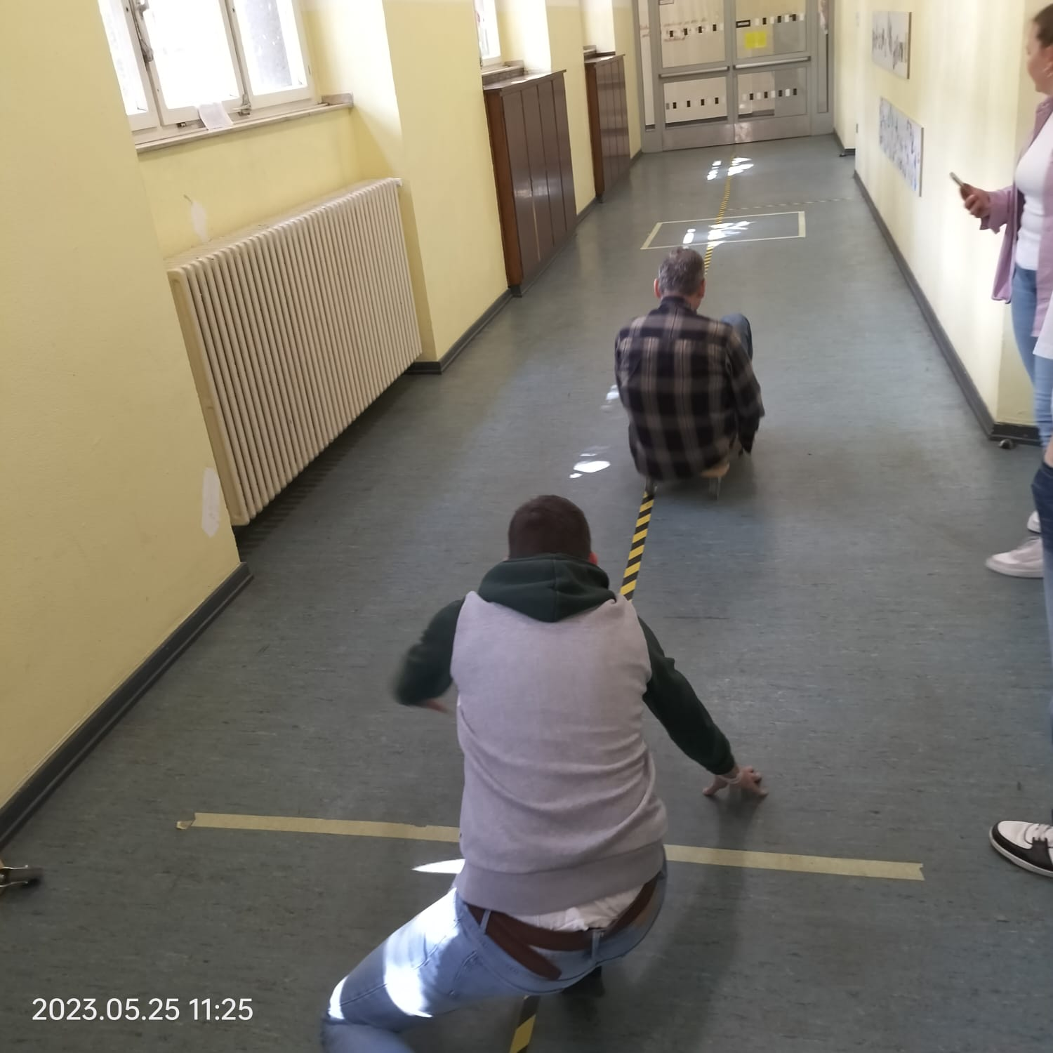
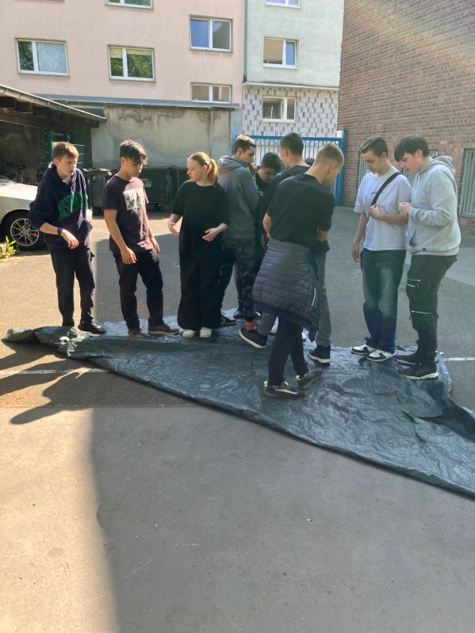
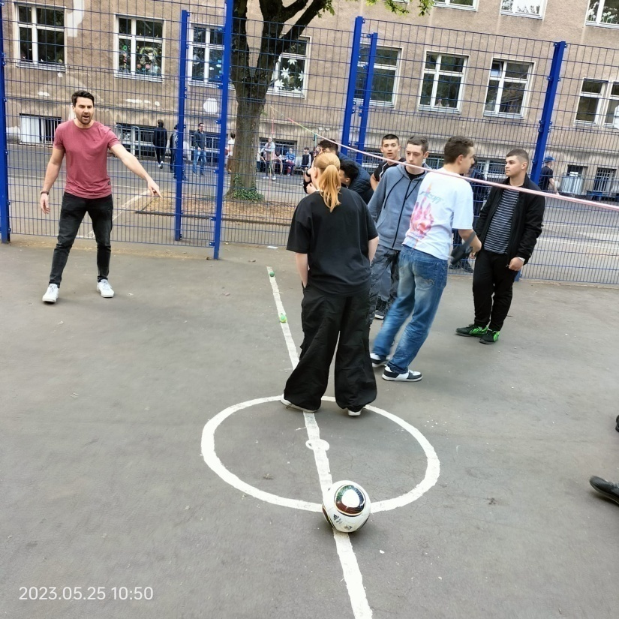
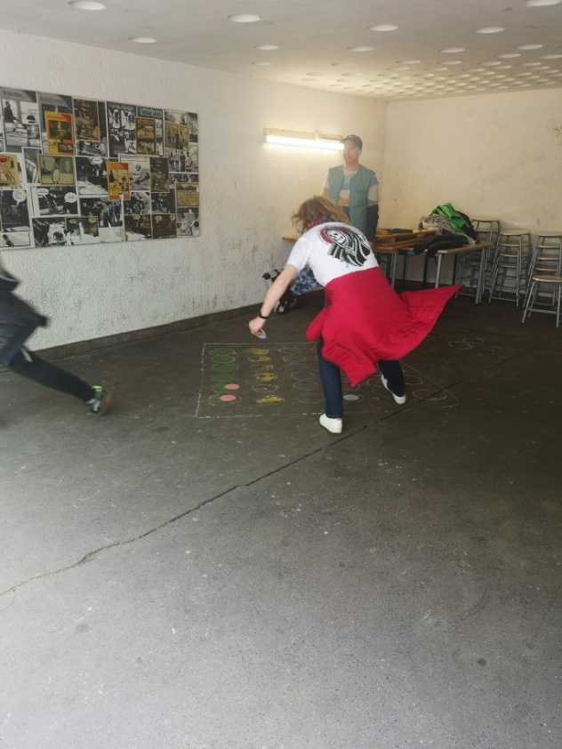
We had 12 different stations at the sportevent.
1. Rain pipe
2. Rollerboard-curling
3. Turning plans
4. Target hit
5. Ping, ping, pong
6. Double
7. Frisbee golf
8. Goal wall shooting
9. Team 4 to win
10. Ball over the cord
11. Dodge ball

Slide 33
In the first game we had to bring a ball with pipes on the other side of the floor.

Slide 34
At this station we had to play Double.

Slide 35
On the 3. station we played the Frisbee Golf Game.

Slide 36
At 4. we played Turning Plans.

Slide 37
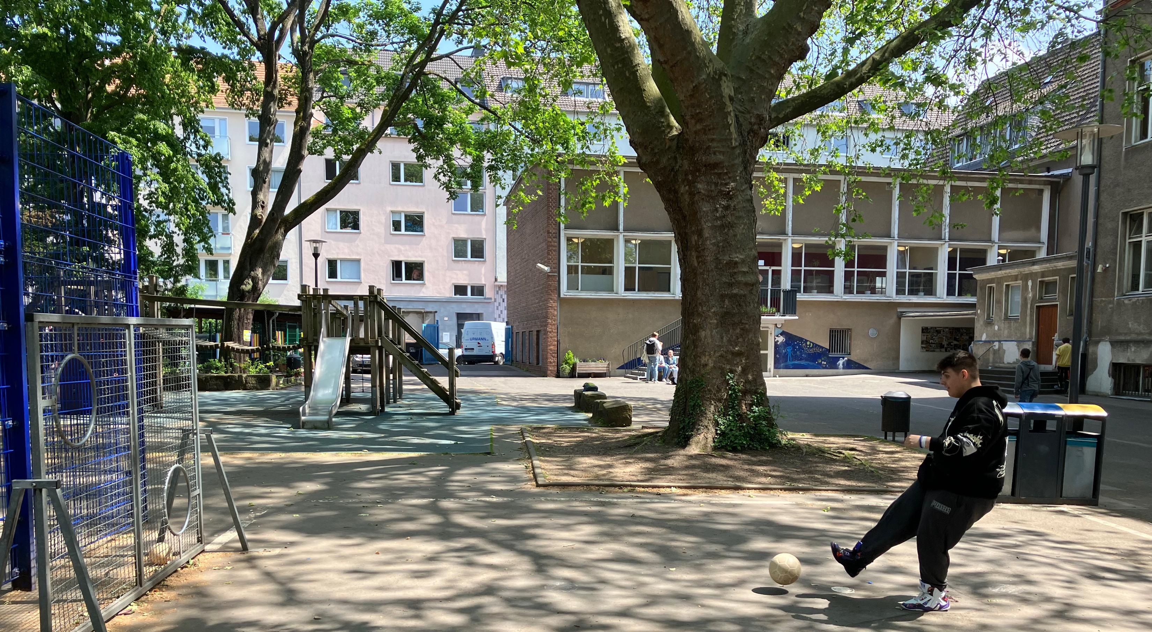
At the 5. game we played Goal Wall Shooting.

Slide 38
At the 6. game we played Ping, Ping, Pong.

Slide 39
At the 7. game we played Bottle Flip

Slide 40
At the 8. game we played Team 4 To Win.

Slide 41
At the 9. game we played Rollerboard-Curling.

Slide 42
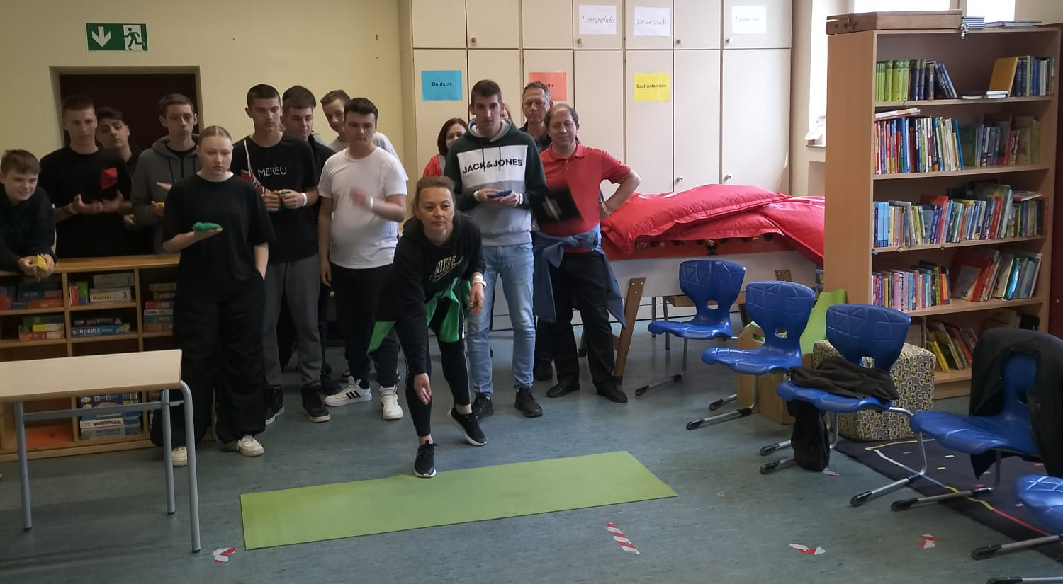
At the 10. game we played Target Hit.

Slide 43
At the end we played Dodge Ball, the students against the teachers.

Slide 44
Winner –the students

Slide 45
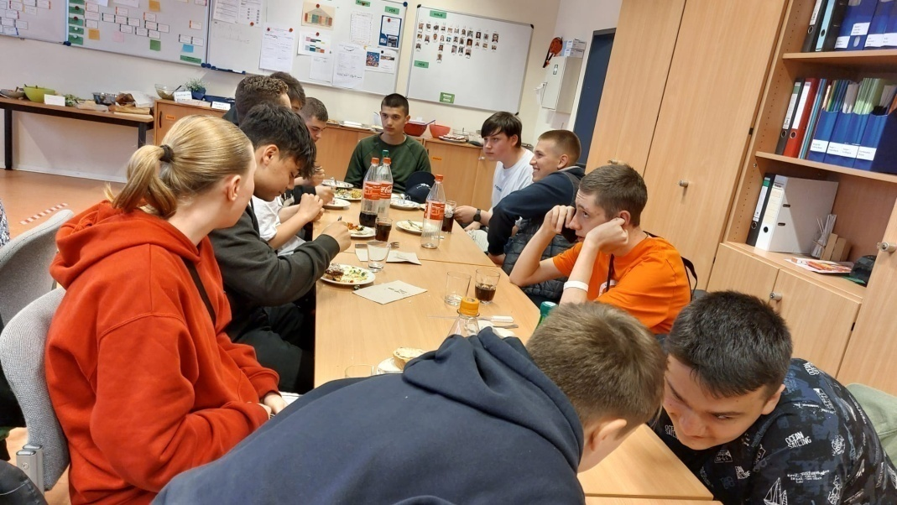
Dinner at School
25.05.2023
In the beginnig we meet each other at the teachers room.
Then we greeted each other.

Slide 46
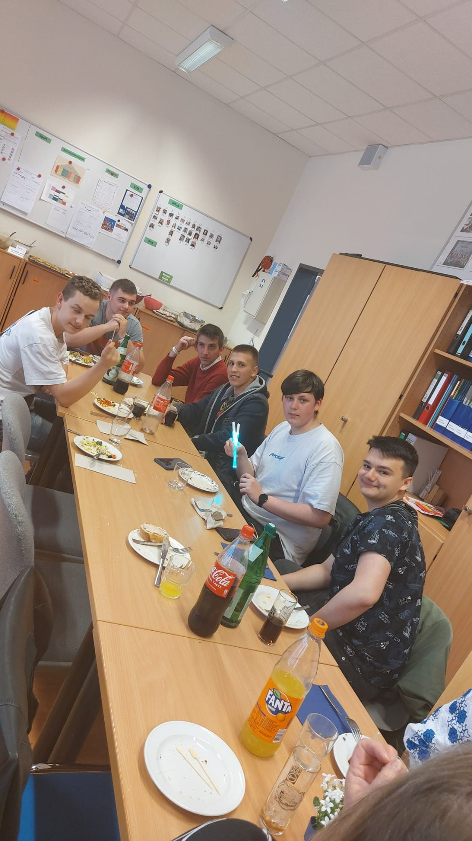
Every teacher brought some food for the dinner.
All the teachers and the students settle down and ate the food what they brought. It was exiting and we all laugh.

Slide 47
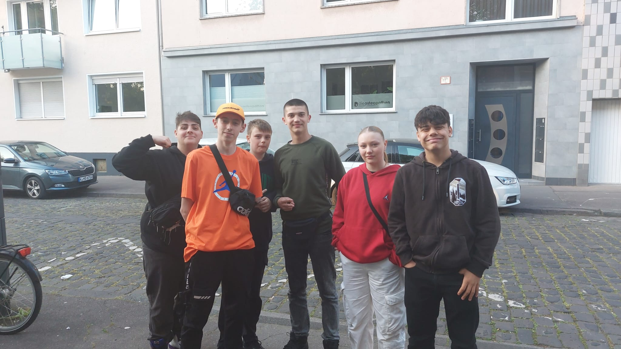
We spent some time together without the teacher. And we had a great time together.
And we talked about all activities in this week. We laught a lot!

Slide 48
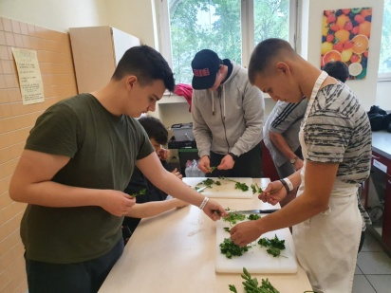
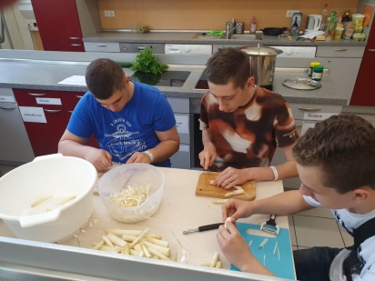
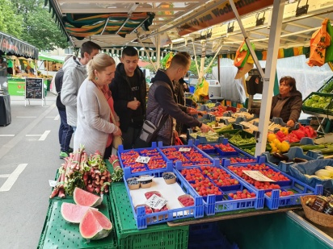
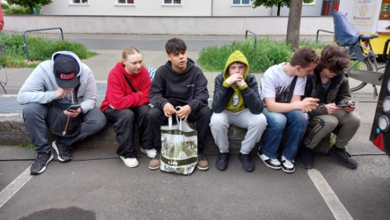
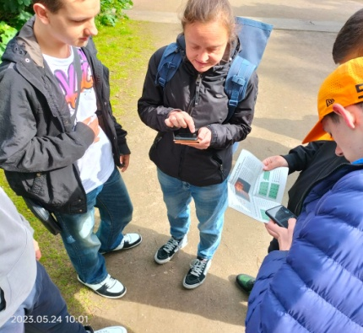
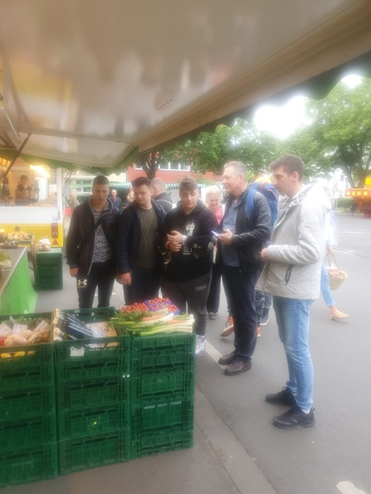
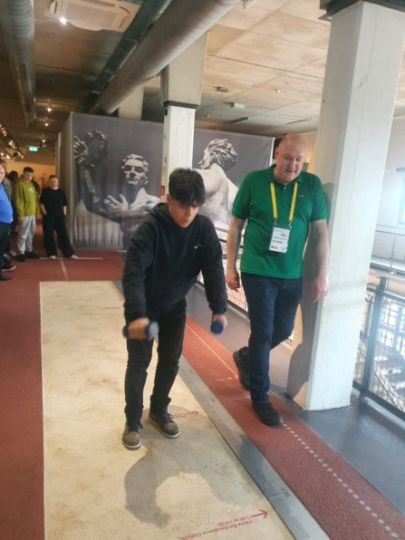
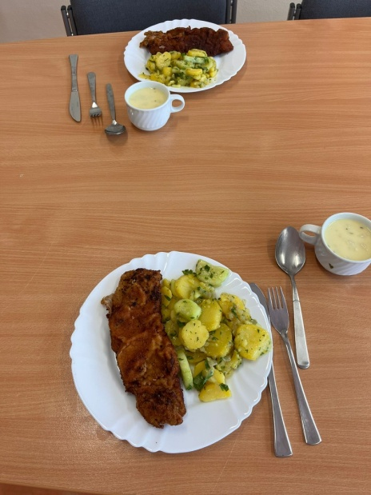
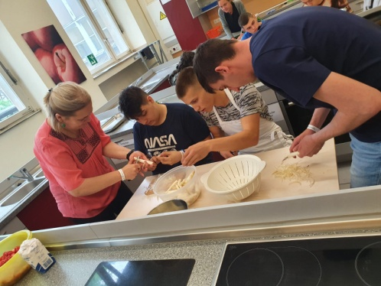
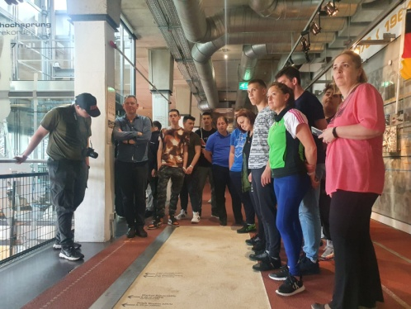
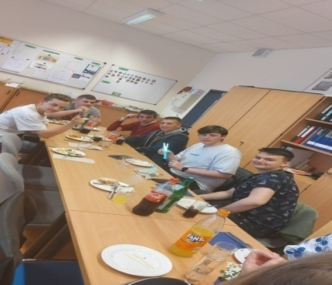
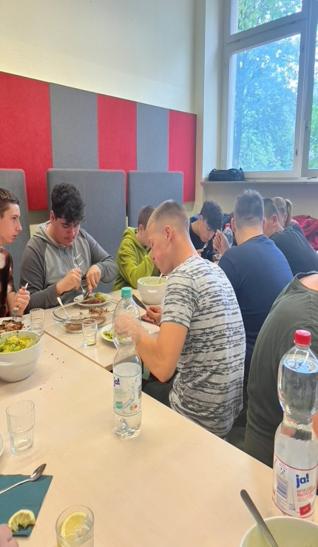
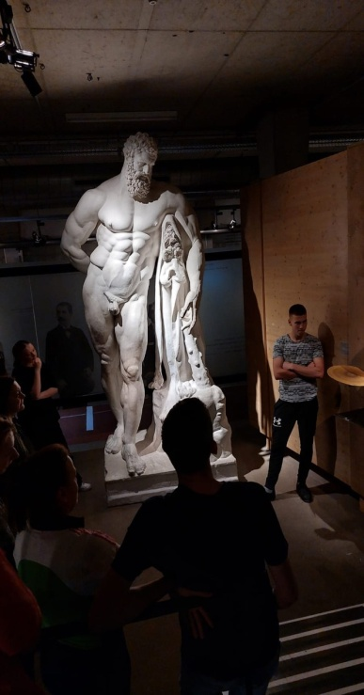

Slide 49
It was a nice week!

